Slide 1
Digital Logic Design
234262
Alex Bronstein
Lecture 3: Memory and Buses

Slide 2
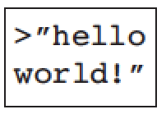
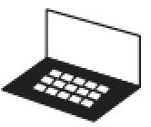
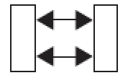
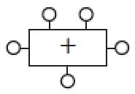
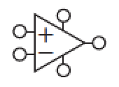
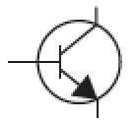
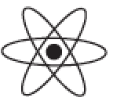
Abstraction Hierarchy
Application Software
Operating System (threads, files, exceptions)
Computer Architecture (instruction set)
Micro-Architecture (execution pipeline)
Logic (adders, multipliers, FSMs)
Digital Circuits (gates)
Analog Circuits (amplifiers)
Process and Devices (MOS FET transistors)
Physics (electrons, holes, tunneling, band gap)

Slide 3
Reminder: D Flip Flop
Positive edge-triggered D flip-flop (DFF)
Logical characteristic:
Output Q assumes the value of D after CLK rise
Timing characteristic:
If input is held constant t_{SU} before
and t_{H} after clock rise then
old output will stay valid at least t_{cCQ}
and new output will become valid
at most t_{pCQ} after clock rise
D
Q
CLK
CLK
t_{SU}
t_{H}
D
NEW
t_{cCQ}
Q
OLD
NEW
t_{pCQ}

Slide 4
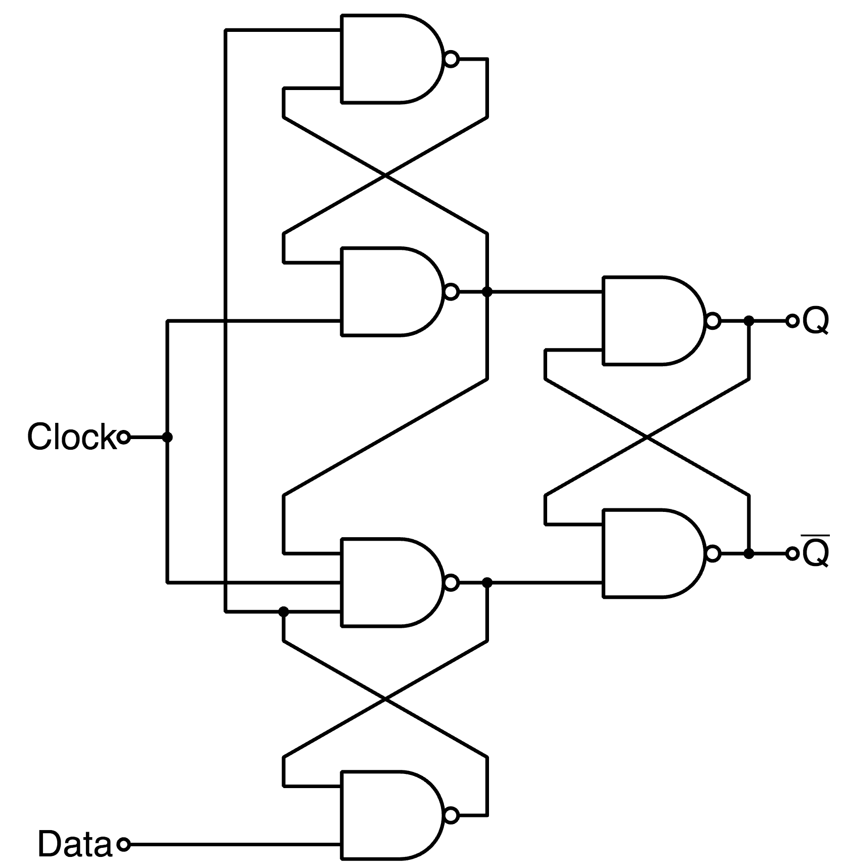
Under the Hood
1 DFF = 2×gated D-latches
Based on positive feedback
of inverting gates
~20 transistors / bit of memory
Pros:
Fast!
Cons:
Chip area (=$)
Power

Slide 5
Memory Array
Many circuits can be shared in
a memory array
N address bits (2^{N} addresses)
M bits word width
Decoder selects and asserts
a wordline
Data stored in bit cells are transferred
to or from bitlines
One word can be accessed at a time
Memories differ mainly by the bit cell structure
0
wordline 0
1
N
stored
bit cell
ADDR
.
.
.
N:2^{N} DECODER
bitline 0
2^{N}
D_{M-1}
D₁
D₀

Slide 6
Multi-Ported Memory Array
N
N
A1
A2
N:2^{N} DECODER
N:2^{N} DECODER
D₀
Allows more than one word to be accessed at the same time
Used for register files and video memories

Slide 7
Illustrative Read Cycle
N
t_{RC}
A1
WE3
N
M
A2
RD1
A1
N
M
t_{AA}
t_{OH}
A3
RD2
N
RD1
OLD DATA
DATA VALID
WD
CLK
2 read ports: Address A1 onto data output RD1, A2 onto RD2
Read cycle is driven by address line
t_{RC} – read cycle time
t_{AA} – address access time (propagation delay)
t_{OH} – output hold from address change (contamination delay)

Slide 8
Illustrative Write Cycle
N
CLK
A1
WE3
N
M
A2
RD1
WE3
N
M
t_{AS}
t_{WR}
A3
RD2
M
A3
WD
t_{DW}
t_{DH}
CLK
WD
DATA VALID
1 write port: Writes data WD onto address A3 on clock rising edge if write enable WE3 is asserted
t_{AS} – address setup before WE3 is asserted
t_{WR} – write recovery (address hold)
t_{DW}, t_{DH} – write data setup/hold times

Slide 9
Memory Types
Random Access Memory (RAM) – volatile
Static RAM (SRAM)
Dynamic RAM (DRAM)
Read-Only Memory (ROM) – non-volatile
ROM
Programmable ROM (PROM)
One-time programmable (OTP)
Erasable PROM (EPROM)
Electrically Erasable PROM (EEPROM)
Flash Memory

Slide 10
Static Memory (SRAM)
Cross-coupled inverters to store bit
2 access transistors to read/write data
6 transistors / bit
Multiported SRAM is used to implement
register files
Pros:
Fast (but slower than FF)
Cons:
Chip area (but less than FF)
bitline
bitline
wordline

Slide 11
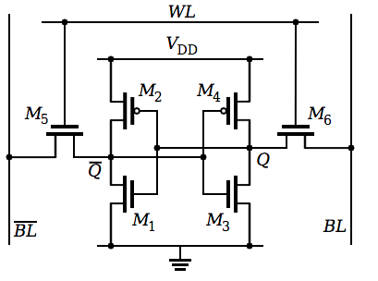
Static Memory (SRAM)

Slide 12
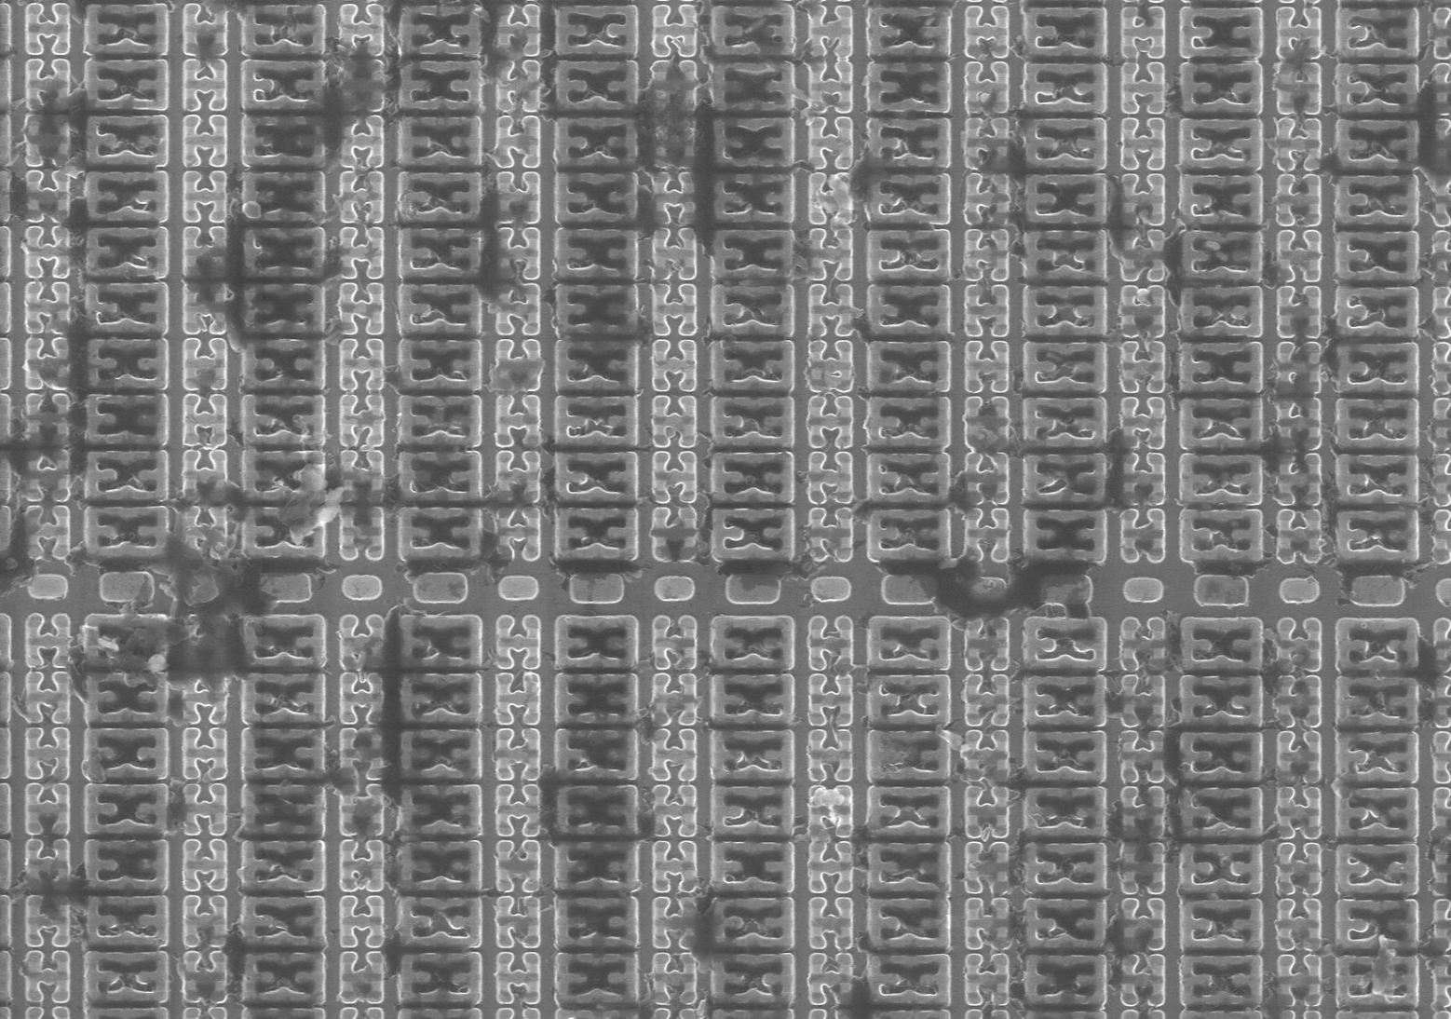

Slide 13
Dynamic Memory (DRAM)
Capacitor to store bit
Access transistor to read/write data
Read is destructive
Pros:
Area
Cost
Cons:
Slow (output not actively driven by a transistor)
Power (due to refresh)
More complicated controllers
Row open latencies
bitline
wordline

Slide 14
Non-Volatile Memory (ROM)
Access transistor: 0 bit
No transistor: 1 bit
Content established at manufacturing
Fuse programmable ROM
(aka one-time programmable, OTP):
Transistor is present in all cells
Fuse blown once to program content
bitline
bitline
wordline
bit 1
bit 0
bitline
bitline
wordline
bit 1
bit 0

Slide 15
EPROM/EEPROM
Floating gate transistor
Programming by application of higher voltage
(hot charge injection into floating gate)
Erasure by
EPROM: exposing the die to UV light
EEPROM: applying reverse voltage (electron tunneling from
floating gate)
bitline
wordline

Slide 16
Look-up Table (LUT)
ROM can implement any CL function
N-bit address, M-bit word width = N-bit input, M-bit output
Often used for controllers, FSMs, nonlinear transformations
Depending on the function, logic/arithmetic implementation might be advantageous

Slide 17
System Bus
From Latin omnibus (=“for all”); English plural: buses or busses
A communication system connecting internal components of a computer
Common data highway is cheaper than many point-to-point links
CPU
PRIMARY
MEMORY
SECOND.
MEMORY
I/O
CONTROL
ADDRESS
DATA

Slide 18
System Bus
CPU
PRIMARY
MEMORY
SECOND.
MEMORY
I/O
CONTROL
ADDRESS
DATA
Address bus – selects device (and address within)
Control bus – specifies what action the device needs to perform
Data bus – transfers data

Slide 19
Master and Slave
CPU
PRIMARY
MEMORY
SECOND.
MEMORY
I/O
READ
WRITE
CONTROL
123FA
ADDRESS
<DATA>
DATA
Electrically a bus is a wire (actually, a bundle thereof)
Bus master – device that drives the bus (its output sets the voltage)
Bus slave – device that is driven by the bus (its input receives the signals from the bus)

Slide 20
Tri-State Logic
1
1
X
0
1
BUS
1
CPU OUTPUT
RAM OUTPUT

Slide 22
Tri-State Logic
EN
EN
Add Enable signal to disconnect output from the bus
When disconnected, the output is floating (high impedance, high Z)

Slide 23
Tri-State Logic
Tri-state buffers
Tri-state inverters
Active high enable
Active low enable
Active high enable
Active low enable
X
Y
X
Y
X
Y
X
Y
_
_
E
E
E
E
_
_
E X Y
0 0 Z
0 1 Z
1 0 0
1 1 1
E X Y
0 0 0
0 1 1
1 0 Z
1 1 Z
E X Y
0 0 Z
0 1 Z
1 0 1
1 1 0
E X Y
0 0 1
0 1 0
1 0 Z
1 1 Z
Tri-state logic can be in 3 states: 0, 1, and Z
Buffers amplify signal, improve fanout and isolate systems
Inverters further invert output

Slide 24
Bidirectional Tristate Buffer
to bus
direction
bus
from bus
Allows to access the bus for reading or writing

Slide 25
Bus Arbiter
A multi-master bus requires an arbiter to decide which master is going
to control the bus at each clock cycle
Arbiter can be centralized (a dedicated circuit) such as in PCI, or
decentralized implementing some handshake protocol

Slide 26
Direct Memory Access (DMA)
Using the CPU to directly control I/O devices can be very costly
It would be better if an I/O device (e.g., a harddrive) could transfer data directly to/from RAM without the CPU needing to execute any in/out instructions
Direct Memory Access Controller (DMAC) has the capability to become the bus master to control the bus to transfer data between I/O device and memory
CPU sets up the DMAC to transfer a sequence of bytes
DMAC can handle several concurrent transfers (channels) competing over the bus

Slide 27
DMAC Bus Arbitration
I/O Device
DMAC
Memory
CPU
DMA Request
Hold Request asserted
Hold Acknowledge asserted
DMA Acknowledge
Data transfer via bus
.
.
.
Cycle
stealing
Data transfer via bus
Hold Request deasserted
Hold Acknowledge deasserted

