Slide 1
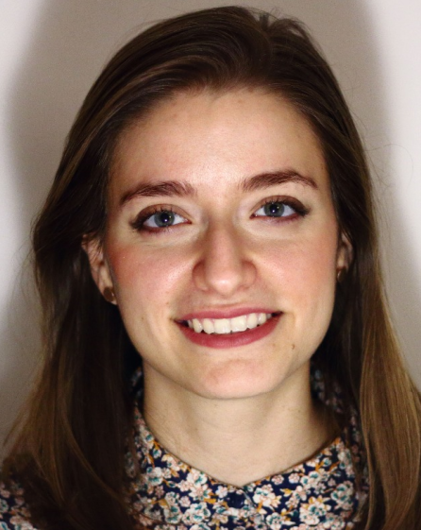
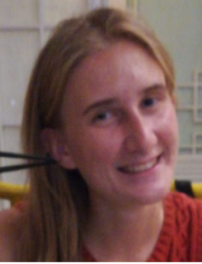
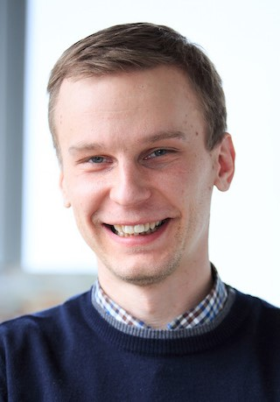
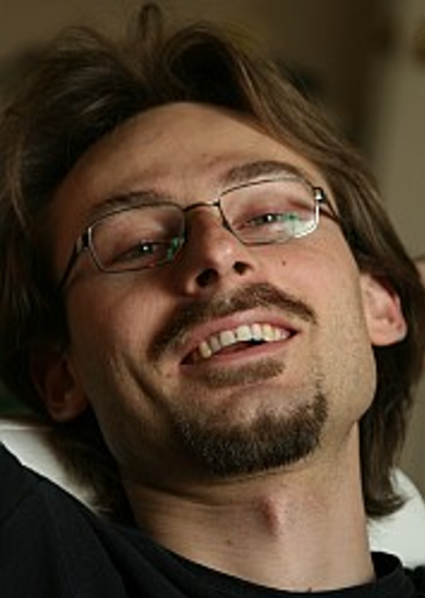
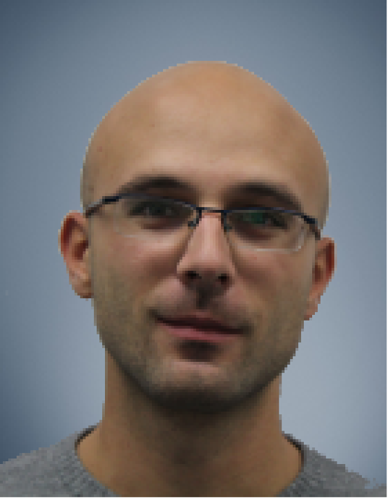



Correspondence-Free Region Localization for Partial Shape Similarity via Hamiltonian Spectrum Alignment
Arianna Rampini¹
Irene Tallini¹
Maks Ovsjanikov²
Alex Bronstein³
Emanuele Rodolà¹
1
2
3
September 17th, 2019, International Conference on 3D Vision 2019, Québec City, Canada

Slide 2
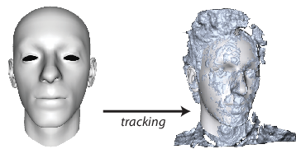
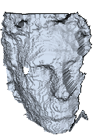
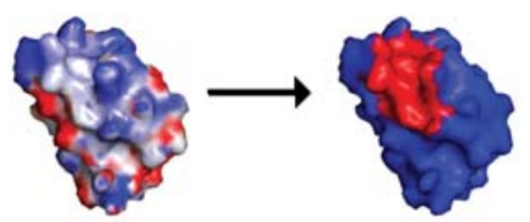
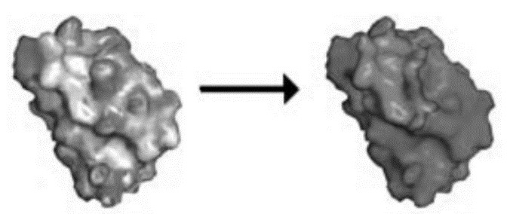
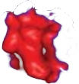
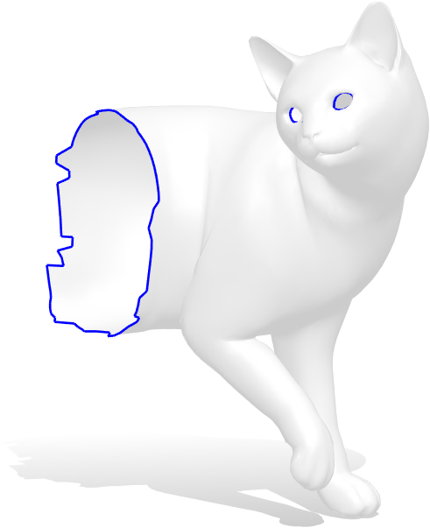
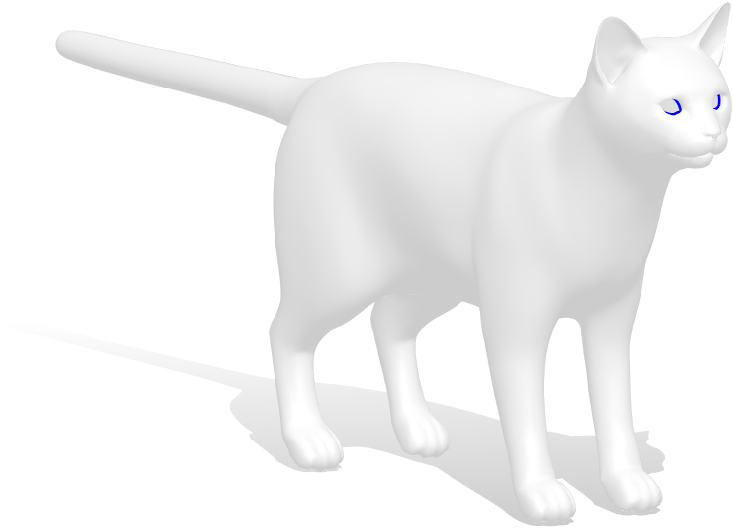
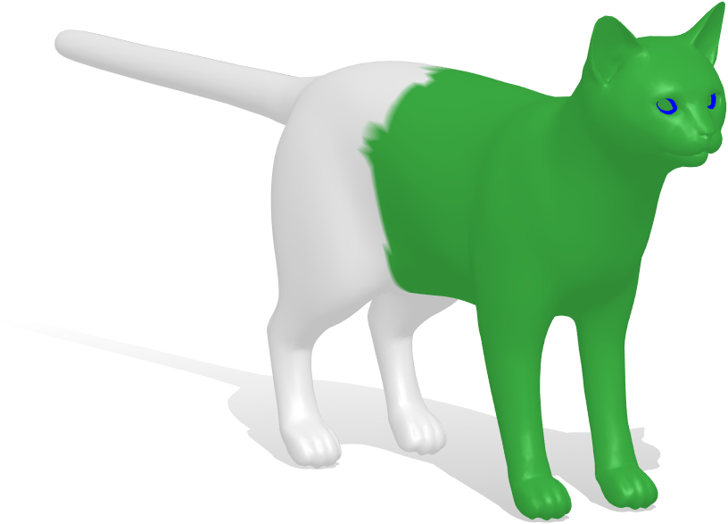
Goal: Partial Shape Similarity
Template
Scan
Registration
Protein A
Protein B
Interface / Non-interface
Partial shape
Full shape
Mask
Notes:
PROBLEM:
Suppose we are given a partial 3D query and a full shape, our goal is to find the mask of the partial shape on the full shape
INTERESTING
bc it is a common problem in applications that involve for example 3D scan and it also appears often in bioinformatics
DEFORMABLE SHAPES

Slide 3

Background: Laplace-Beltrami operator
Notes:
To address this task our main tool will be laplacian defined on shapes called lb operator

Slide 4
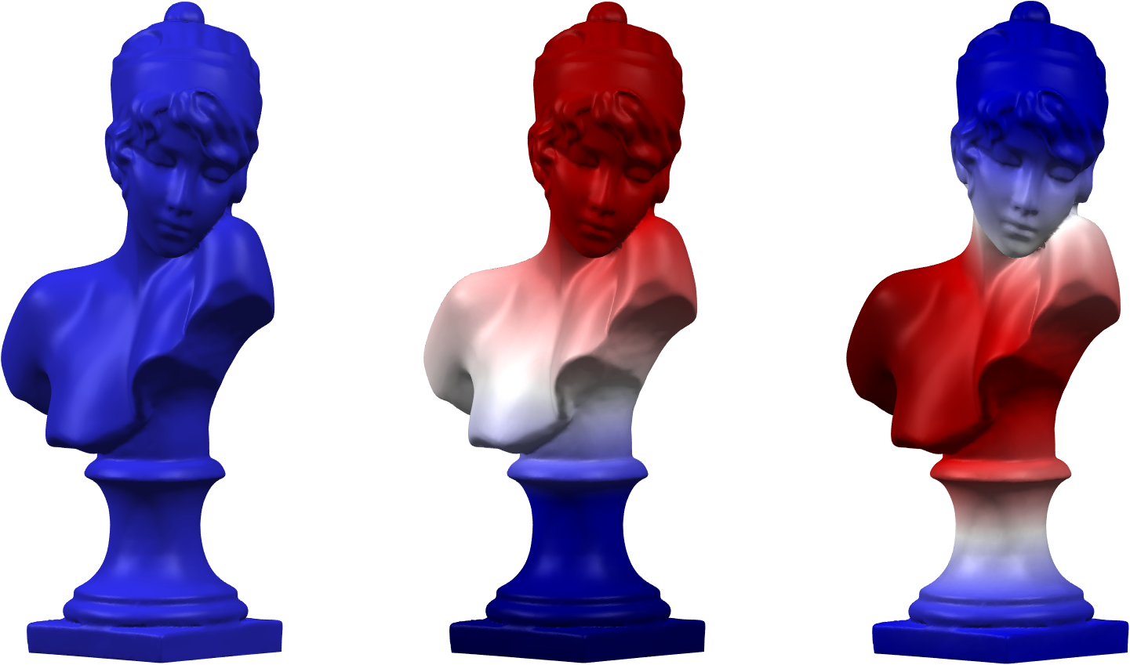
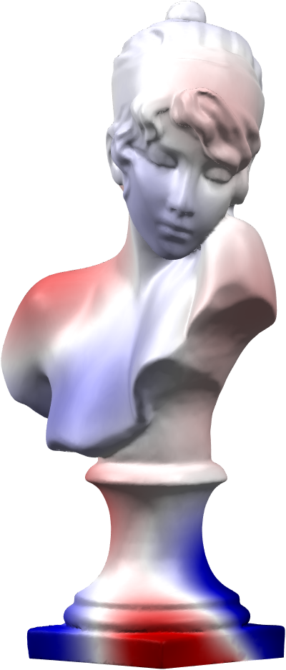
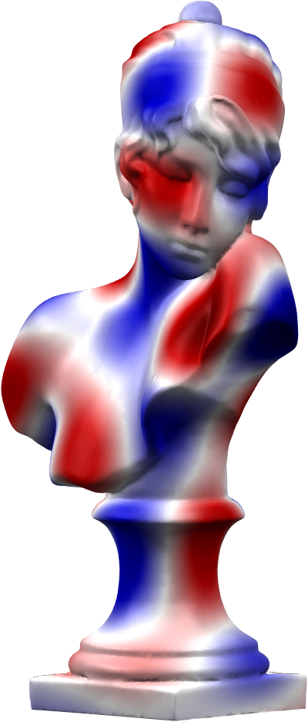
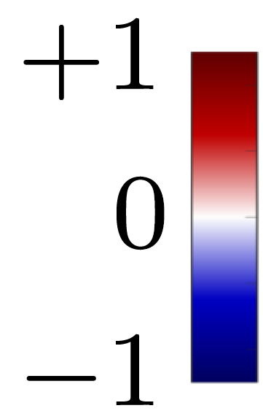
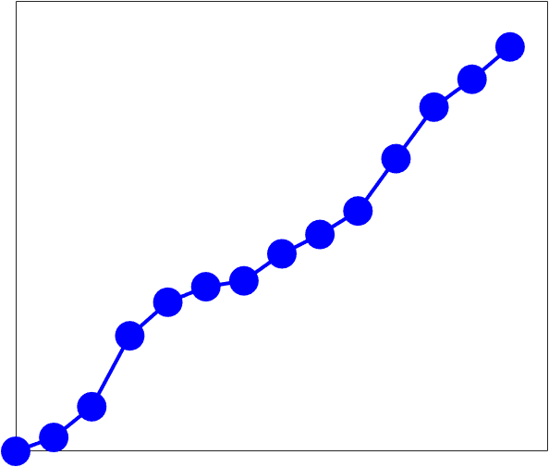







Background: Laplace-Beltrami operator
Laplacian spectrum
…
…

Slide 5

Background: Laplace-Beltrami operator
Laplacian spectrum
…
…
Notes:
we will use only the lowest part of spectrum but eigenvalues and eigenfunctions strictly connected : In particular each ev is given by the associated eigenfunction in term of this relation
- Invariant to isometric trasformation like changes in the pose
- Ideally invariant to the discretization

Slide 6
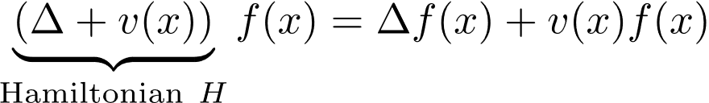
Background: Hamiltonian operator
Potential function

Slide 7

Background: Hamiltonian operator
Potential function

Slide 8
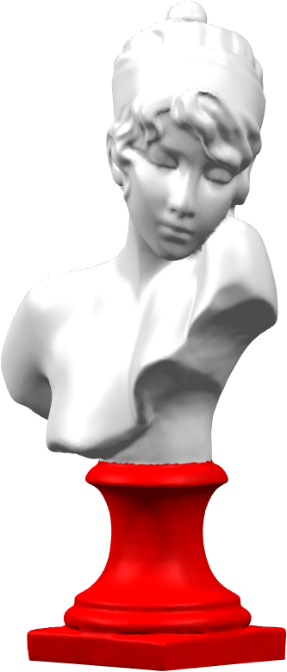
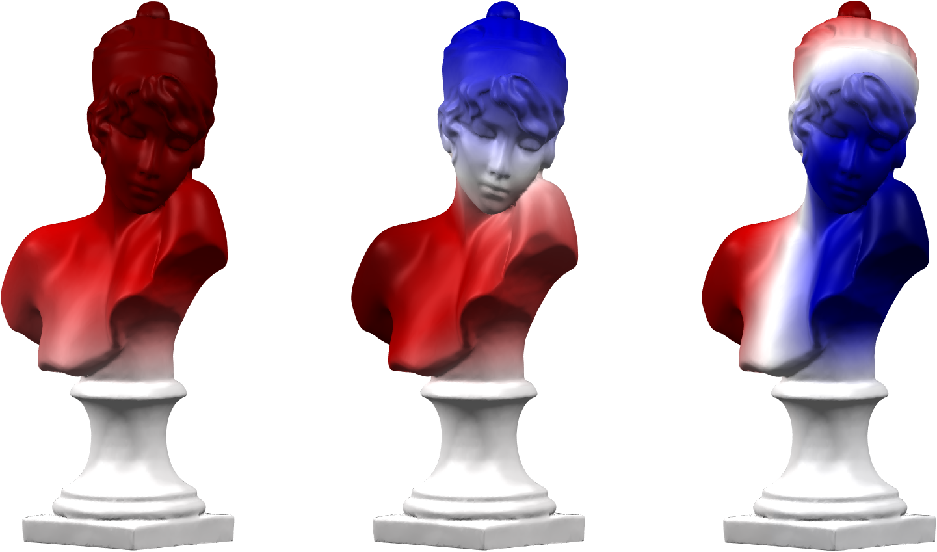
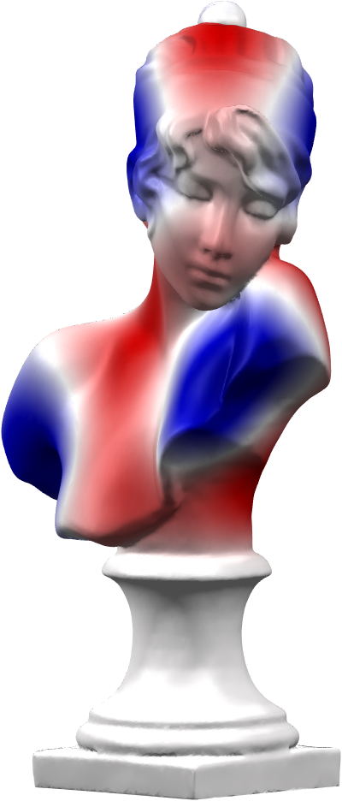
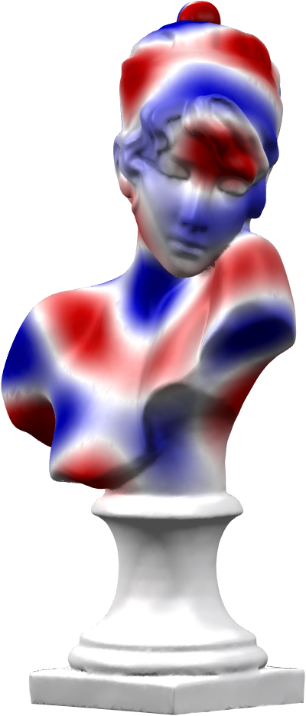
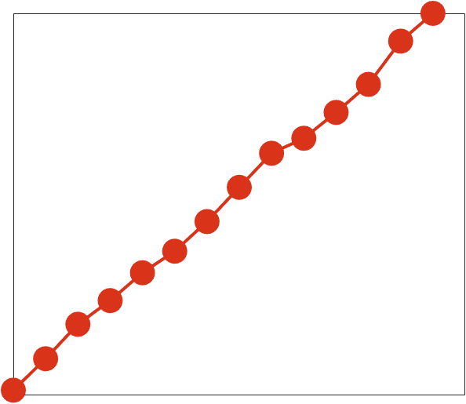
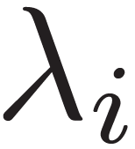





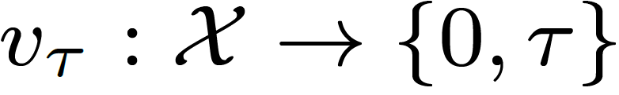
Background: Hamiltonian operator
Step potential
Hamiltonian spectrum
…
…
Notes:
INTERESTED IN THIS OPERATOR bc if our potential is a step function hamiltonian eigenfunctions are entirely localized in the region where v is zero

Slide 9
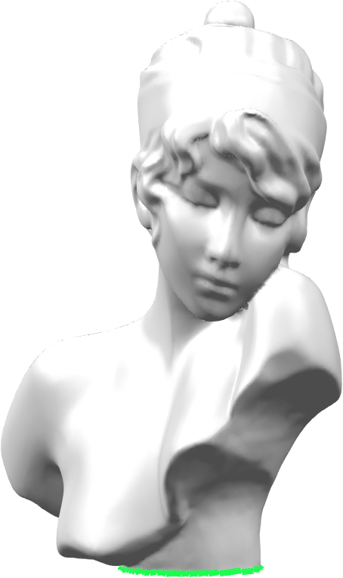
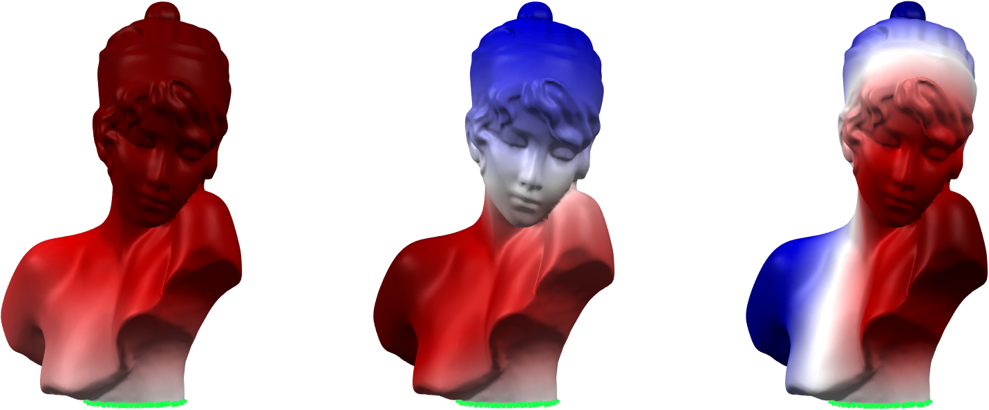
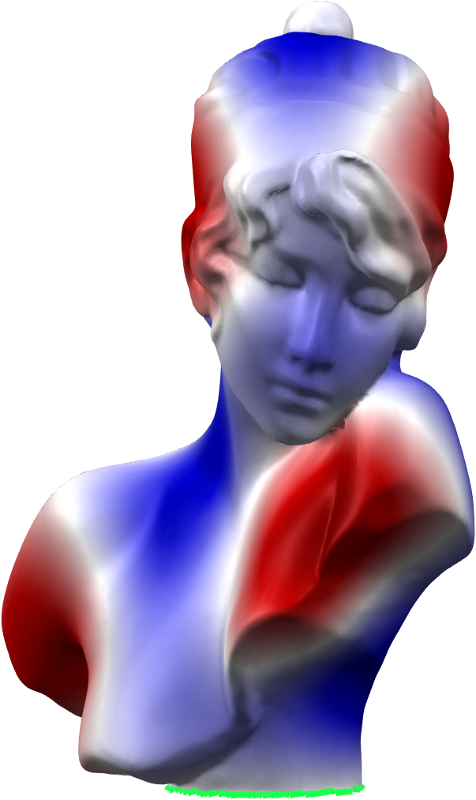
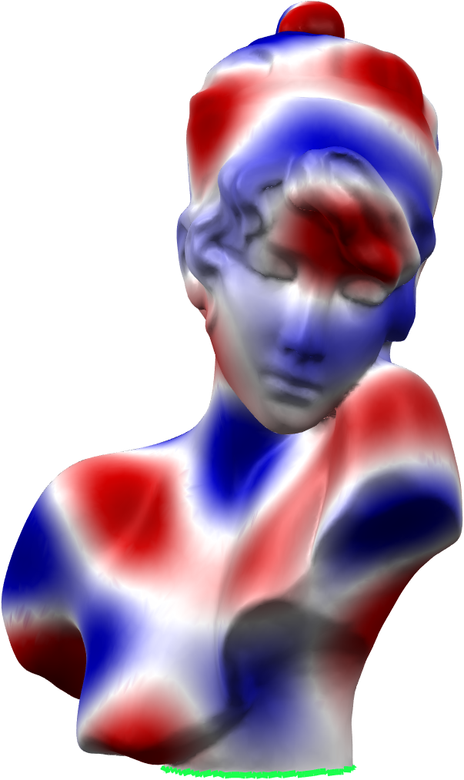

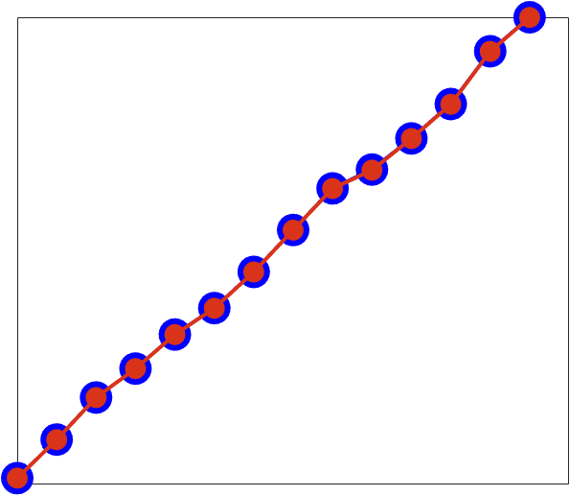
Our approach: main idea
Theorem: There exists a step potential for which the full shape and the partial shape share the same spectrum:
…
…
…
…
Notes:
As a consequence, in the partial setting we can consider a step function that indicates the missing part on the full shape, and we will have that the eigenfunctions are the same on the two shape
we can think of LOOKING FOR IT IN AN OPTIMIZATION PROBLEM, minimizing the difference between the two spectra

Slide 10

Optimization problem

Slide 11
Optimization problem

Slide 12
Optimization problem

Slide 13
Optimization problem
Notes:
We want to minimize this norm over the space of all possible potential, bc if it is zero the potential identifies the missing part on the full shape

Slide 14

Optimization problem
Notes:
Weithget norm to balance the contribution of each pair of eigenvalues

Slide 15
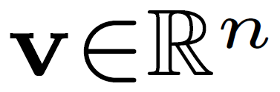
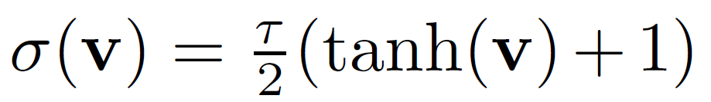
Optimization problem
Implementation details:
Optimize over with saturation
Trust Region
Initialization: multistart
Notes:
We force the potential to be a step function with a saturation function

Slide 16
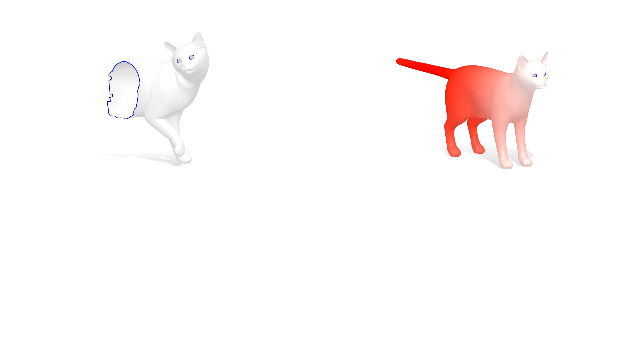

Slide 17
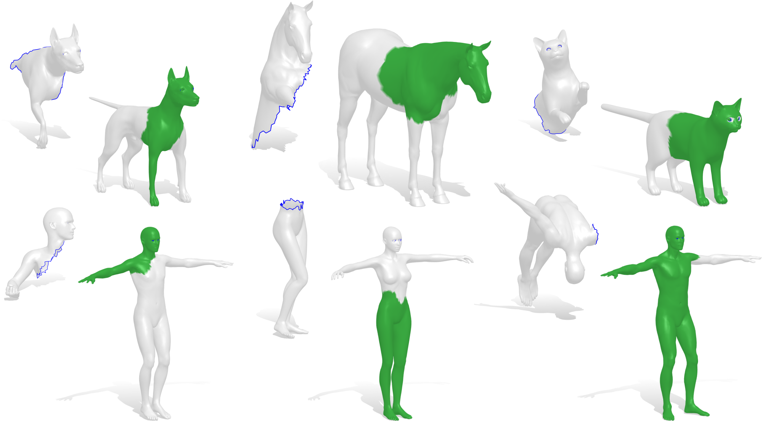
Examples
0.90
0.85
0.95
0.96
0.99
0.98
Notes:
Some qualitative results

Slide 18
Pros
Correspondence-free
Invariance to isometries
No descriptors in the optimization

Slide 19
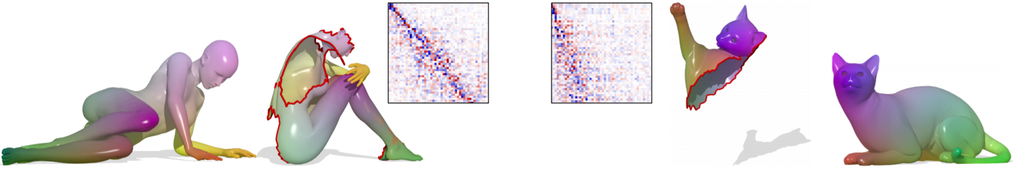
State of the art: Partial Functional Maps (PFM)
Rodolà et al., Partial Functional Correspondence (CGF 2017)
Notes:
it makes an extensive use of descriptors and it computes also correspondences togheter with the masks, so it is computationally more expensive

Slide 20
Qualitative comparisons
0.38
0.96
0.62
0.96
0.39
0.79
0.48
0.77
Notes:
Our solution looks more clean bc the fact that we use only ev act like a regularization, while pfm messes up with SIMMETRIES of the shapes

Slide 21
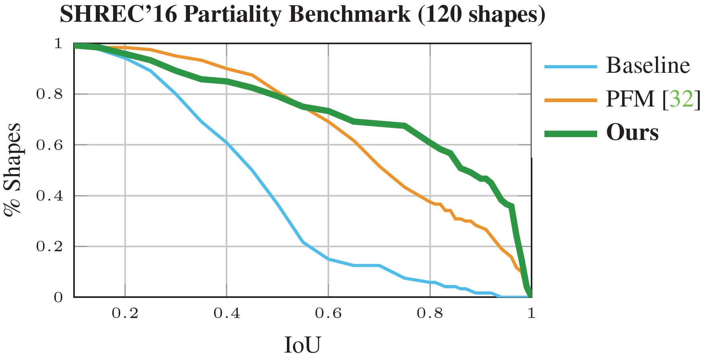
Extensive evaluation
Rodolà et al., Partial Functional Correspondence (CGF 2017)
Notes:
Baseline is a naive approach called bag of features, that basically uses nearest neighbour in the space of the descriptors

Slide 22
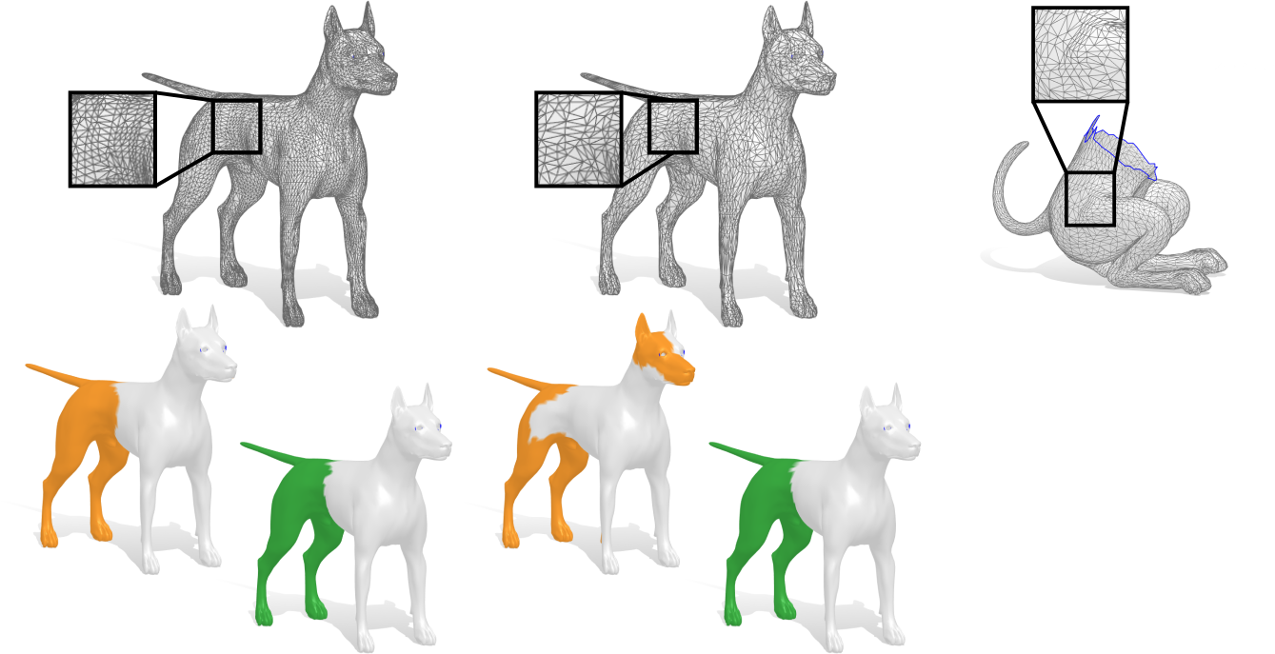
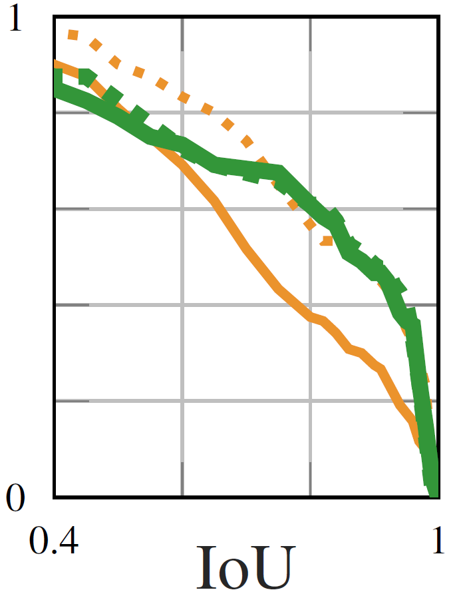
Advantages: Robustness to sampling
10000 vertices
5000 vertices
Target
PFM
Ours
PFM
Ours
Notes:
We tried to remesh all the templates to a lower resolution. In the plot continous line represent the result obtained on the remeshed dataset and the dot lines represent the result obtained with the original dataset
We can see that in our case the two green lines overlap, while pfm which plotted in orange is not robust to the change of vertex density

Slide 23
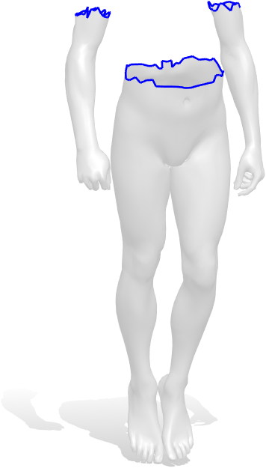
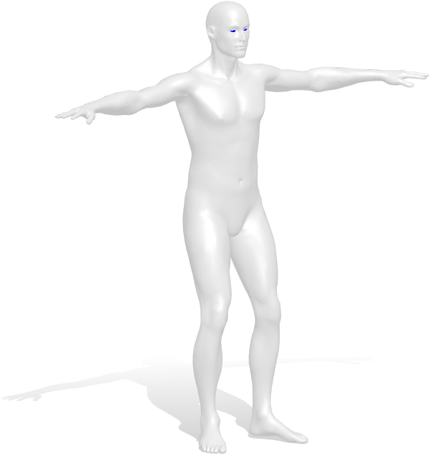
Advantages: Disconnected parts simultaneously

Slide 24
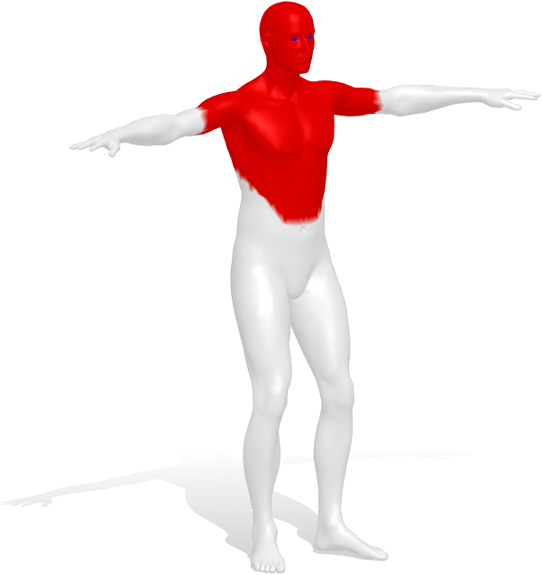
Advantages: Disconnected parts simultaneously

Slide 25
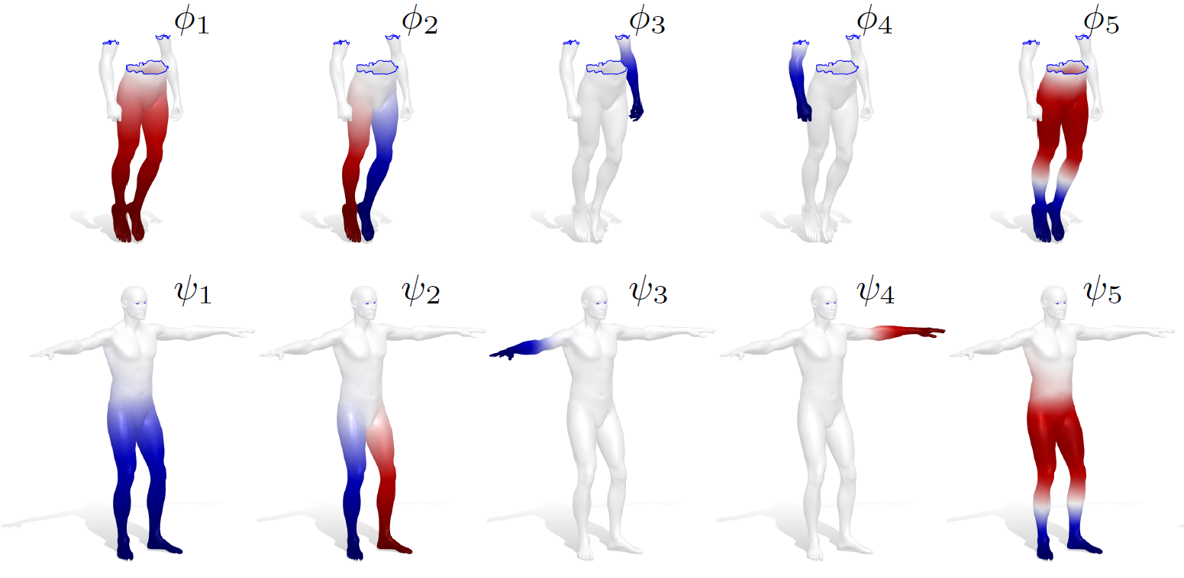
Advantages: Disconnected parts simultaneously
Notes:
With eigenfunctions i can identify each part individually

Slide 26
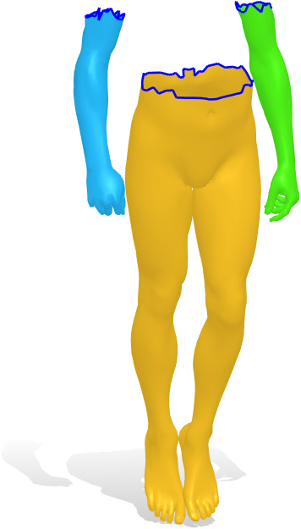
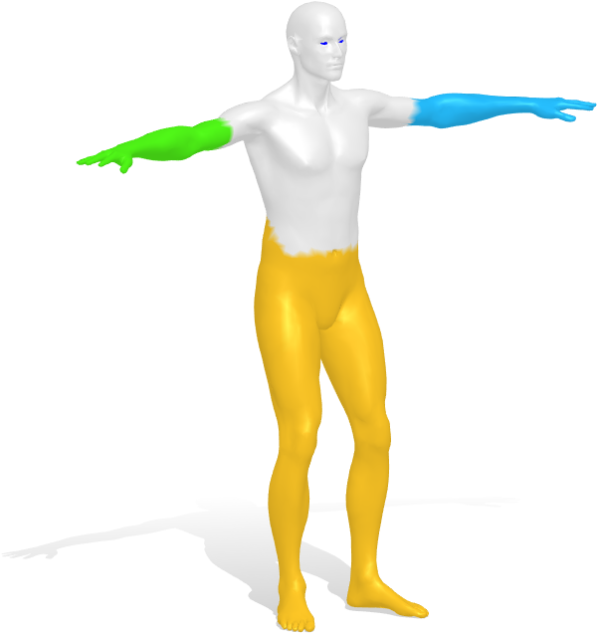
Advantages: Disconnected parts simultaneously

Slide 27
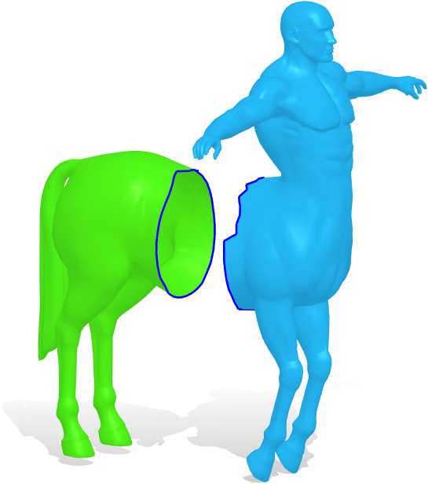
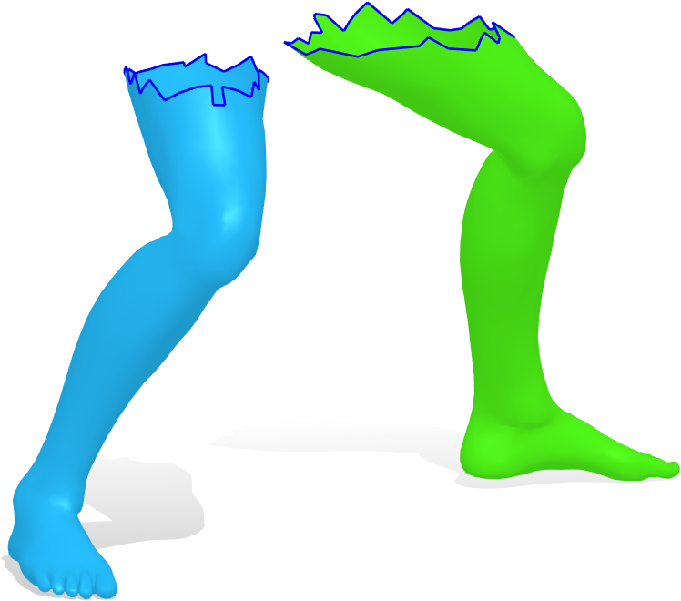
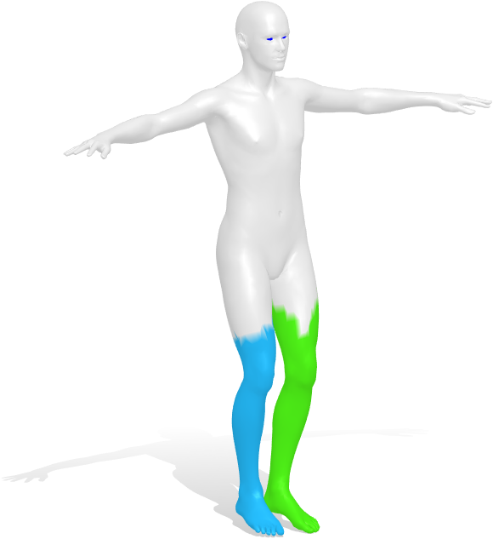
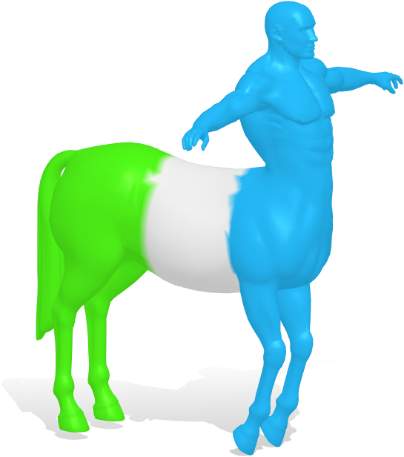
Advantages: Disconnected parts simultaneously

Slide 28
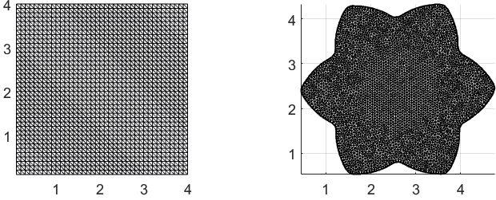


Hearing the shape of the drum
Eigenvalues of the Hamiltonian
Eigenvalues of the Laplacian
Kac M., “Can one hear the shape of the drum?” (1966)
Notes:
We can see it as a case of partiality in the plane and then look for a potential on a 2D grid

Slide 29

Hearing the shape of the drum
Eigenvalues of the Hamiltonian
Eigenvalues of the Laplacian
Kac M., “Can one hear the shape of the drum?” (1966)

Slide 30

Comparison with Isospectralization
Isosp. Ours
Isosp. Ours
Isosp. Ours
Initialization
Result
Target
Cosmo et al., Isospectralization, or how to hear shape, style and correspondence (CVPR 2019)
Notes:
In a previous work we tried to do the same deforming a mesh. This was limiting first of all bc we had to give the correct topology as an input and then bc deforming meshes is more computationally expensive.
FINALE AD EFFETTO
Questo ci porta più vicino ad applicazioni fantascentifiche come quella di riconoscere la forma degli oggetti dal suono

Slide 31
Conclusions and future directions
New approach for partial shape similarity
Short sequences of eigenvalues encode the geometry of shapes
Improve robustness to noise
Learning pipeline
Notes:
I think that one of the most interesting thing of this work is that it turned out that spectra encode a lot of the geometry of the shapes and this is
Surprising bc we are talking about only a bunch of numbers
Could be usefull in other application, for example it could be included in learning pipelines
One of our goals for future works is to improve the robustness to noise to use the method on real dataset.

Slide 32
Conclusions and future directions
New approach for partial shape similarity
Short sequences of eigenvalues encode the geometry of shapes
Improve robustness to noise
Learning pipeline
Thank you!
Notes:
I think that one of the most interesting thing of this work is that it turned out that spectra encode a lot of the geometry of the shapes and this is
Surprising bc we are talking about only a bunch of numbers
Could be usefull in other application, for example it could be included in learning pipelines
One of our goals for future works is to improve the robustness to noise to use the method on real dataset.

